Slide 1
ALGORITHM TO PERFORM FLUSH Air DATA SENSING (FADS)

Slide 2
OVERVIEW
INTRODUCTION
PROBLEM STATEMENT (OBJECTIVE )
ALGORITHM
APPLICATION OF ALGORITHM – (ON ABSTRACT PRESSURE DATA OBTAINED FROM SIMULATION OF 2D AEROFOIL).
RESULTS AND CONCLUSION

Slide 3
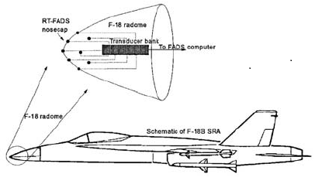
INTRODUCTION
Fig. FADS Installation at nose of F-18 aircraft.
Flush air data sensing system (FADS) forms admission-critical subsystem in re-entry vehicles. It makes use of surface pressure measurements from the nose cap of the vehicle for deriving air data parameters such as angle of attack, angle of sideslip, Mach number, etc. of the vehicle. These parameters are used by the flight control and guidance systems, and also assist in the overall mission management. The Space Shuttle has used a nonlinear regression based algorithm for this. ‘Triples’-based algorithm was proposed for the X-33 vehicle. Neural network-based systems were also developed for FADS.
Aerodynamic models –Approximate equations used to estimate data
Calibration-
Using correction data sets
Static Pressure measured by pressure ports .
Air data sets

Slide 4
OBJECTIVES
MAIN OBJECTIVE
To come up with an algorithm which involves search and interpolation approaches to find out the aerodynamic parameters like angle of attack(α), Mach-number (M), Side-slip angle(β) & Altitude (h) corresponding to the pressure measured by Transducers .Algorithm eliminates the dependency on Aerodynamic models for data interpretation.
To find suitable location for Pressure Transducers on Aircraft’s body such that measurement is not affected by the disturbing flow field around the aircraft.
CURRENT OBJECTIVE
To develop an algorithm and apply it to find the aerodynamic parameter α & M corresponding to the pressures on five locations present on the 2D aerofoil and validate it with results of simulation performed in HI-FUN 3D.

Slide 5
ALGORITHM
Structural Arrangement of Dataset (pressure)
1. Arranging Pressure data obtained from experiments or Simulations at different aerodynamic condition.
Search Operation to find input data location.
2. Searching common location for given input pressure values.
3. After finding common location performing Bilinear Interpolation.
Bilinear Interpolation operation.
4. After Bilinear interpolation Aerodynamic Parameters are obtained .
Output
Aerodynamic parameter
Fig. Algorithm Flow Chart

Slide 6
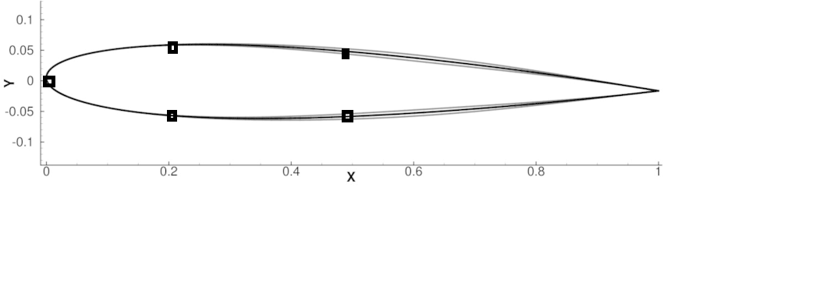
APPLICATION OF ALGORITHM
Euler Simulation on 2D Aerofoil (NACA 0012) is performed and pressure values at different M and α is used to check the algorithm and to find the error.
Port2 (P2)
Port4 (P4)
Port1 (P1)
Port3 (P3)
Port5 (P5)
Fig . NACA 0012 Aerofoil
Positions of location selected for ports
Port1 – Leading edge .
Port2 & port3 – 20% of chord length.
Port4 & Port 5- 50% of chord length.

Slide 7
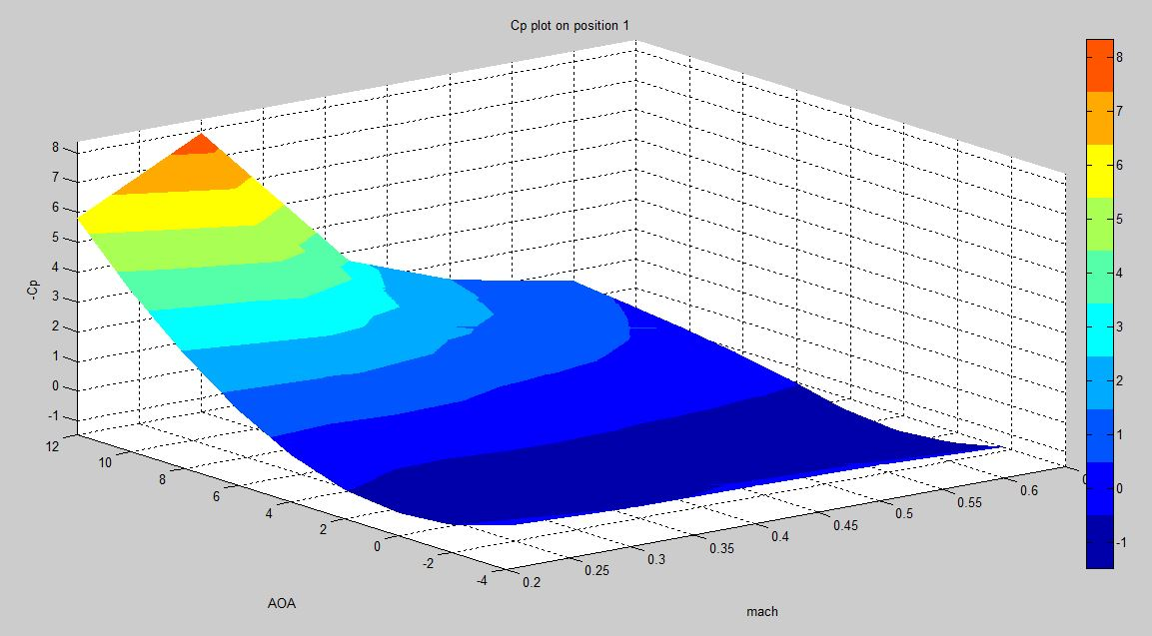
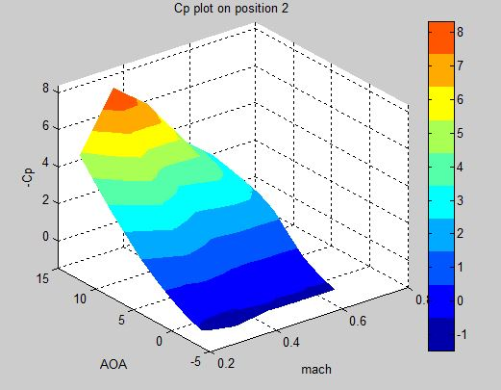
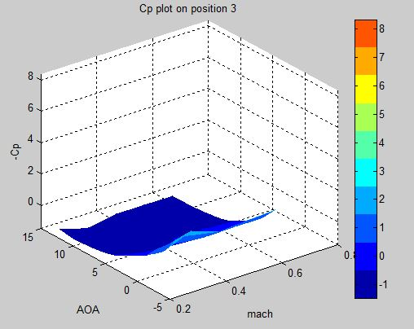
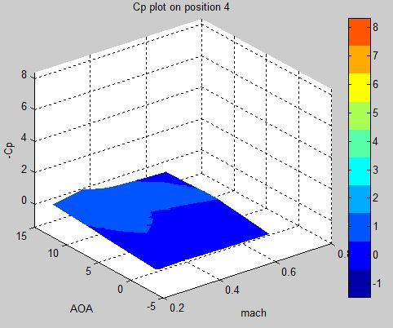
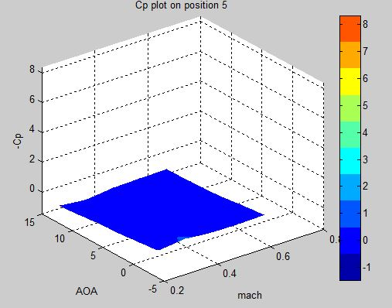
Plots of Cp values on M – α carpet.

Slide 8
Arrangement of Dataset (Pressure Data).
12
10
8
6
4
2
0
-2
-4
At each node Pressure at all five ports P1 to P5 is stored for corresponding M and α combinations. As P(M, α).
32 | 31 | 30 | 29
25 | 26 | 27 | 28
24 | 23 | 22 | 21
17 | 18 | 19 | 20
16 | 15 | 14 | 13
9 | 10 | 11 | 12
8 | 7 | 6 | 5
1 | 2 | 3 | 4
(Box.no)1
Angle of attack (α)
At this node
P1(0.2 ,-4) ……to p5(0.2,-4)
0.2 0.3 0.4 0.5 0.6
Mach number (M)

Slide 9
2. Search Operation (for a given input data set)
To make search easier two dimensional boxes are related to one dimensional slots .
2D- BOXES
Let,
P ^{i}_{bmax} = Maximum Pressure of a box.
P ^{i}_{bmin} = Minimum Pressure of a box.
P_{i} = Input Pressure (where i represent port number, i.e. i=1 to 5)
P_{imin} = Minimum Pressure value of a Port
P_{imax} = Minimum Pressure value of a Port
ΔP_{i} = Resolution of a slot ,
ΔP_{i} = (P_{imax} - P_{imin})/ N
N = number of slots
12
10
8
6
4
2
0
-2
-4
32 | 31 | 30 | 29
25 | 26 | 27 | 28
24 | 23 | 22 | 21
17 | 18 | 19 | 20
16 | 15 | 14 | 13
9 | 10 | 11 | 12
8 | 7 | 6 | 5
1 | 2 | 3 | 4
Angle of attack (α)
ΔP_{i}
1 | 2 | 3 | . | . | . | . | . | . | N
P_{imin}
1D -SLOTS
P_{imax}
0.2 0.3 0.4 0.5 0.6
Mach number (M)

Slide 10
Relating 2D Box to 1D slot
We will find the slots in which the box lies by using :
S_{min=} (P ^{i}_{bmin}- P_{imin})/ ΔP_{i} (lower limit of slot number )
S_{max=} (P ^{i}_{bmax}- P_{imin})/ ΔP_{i} (upper limit of slot number )
Box will lie from slot S_{min} to S_{max}
Box 1
P ^{i}_{bmax}
P ^{i}_{bmin}
ΔP_{i}
1 | 2 | S_{min} | . | . | . | . | S_{max} | . | N
P_{imin}
P_{imax}
Example
Finding out slot range for port i=4 , and box =1 where we have , P ⁴_{bmin}= 100269.48 , P ⁴_{bmax}=101095.9
P_{4min}= 88345.06847 & ΔP₄= 398.4625290625
S_{min=} (100269.48- 88345.06847)/ 398.4625290625= 29.92605492430035≈30
S_{max=} (101095.9-88345.06847)/ 398.4625290625= 32
So for pressure 4 Box 1 lies from slot 30 to 32.

Slide 11
Finding Box numbers lying in a slot when a Pressure Input is Given
ΔP_{i}
1 | 2 | 3 | S_{n} | . | . | . | . | . | N
12
10
8
6
4
2
0
-2
-4
32 | 31 | 30 | 29
25 | 26 | 27 | 28
24 | 23 | 22 | 21
17 | 18 | 19 | 20
16 | 15 | 14 | 13
9 | 10 | 11 | 12
8 | 7 | 6 | 5
1 | 2 | 3 | 4
P_{imax}
P_{imin}
If Pressure P_{i} is given then
S_{n}= (P_{i}- P_{imin})/ ΔP_{i} slot number which contains P_{i}
Then there will be boxes In slot where Pressure P_{i} will lie
Angle of attack (α)
Example
If P₄=100900, P_{4min}= 88345.06847 & ΔP₄= 398.4625290625 then
S_{n}= (100900- 88345.06847)/ 398.4625290625
= 31.50843709078281 ≈ 32
So now boxes in which P₄ will lie will be in slot 32 i.e Box1
0.2 0.3 0.4 0.5 0.6
Mach number (M)

Slide 12
Example to find a common box for 5 pressure values
Common box= 18
1 | 2 | 3 | S_{n} | . | . | . | . | . | N
P₁
1 | 2 | 3 | S_{n} | . | . | . | . | . | N
P₂
12
10
8
6
4
2
0
-2
-4
32 | 31 | 30 | 29
25 | 26 | 27 | 28
24 | 23 | 22 | 21
17 | 18 | 19 | 20
16 | 15 | 14 | 13
9 | 10 | 11 | 12
8 | 7 | 6 | 5
1 | 2 | 3 | 4
1 | 2 | 3 | S_{n} | . | . | . | . | . | N
P₃
1 | 2 | 3 | S_{n} | . | . | . | . | . | N
P₄
1 | 2 | 3 | S_{n} | . | . | . | . | . | N
P₅
Angle of attack (α)
Pressure | Boxes
P₁ =101005.992654 | 1,2,15,16,18,19,20,21
P₂ =86124.4920577 | 17,24,25,32,15,18,11,14,12
P₃ =107892.930975 | 15,18,23,26,31,14,12,13
P₄ =97540.108370 | 24,25,32,10,15,18,23,6,11,4,5
P₅ =101108.04109 | 14,24,18,19,20,21
0.2 0.3 0.4 0.5 0.6
Mach number (M)

Slide 13
3.Applying Bilinear Interpolation
Formula derived from Bilinear Interpolation to calculate Mach-Number (M) and angle of attack (α) for two pressure input, which are supposed to be obtained at same M & α
P_{i} =
To solve for Mach number (m) and Angle of Attack (a) we need two equations which can be obtained by choosing any of two pressure values from P₁ to P_{5 .}
[ (α₂-a){(M₂-m) P^{i}₁+(m-M₁)P^{i}₂}+(a-α₁){(M₂-m)P^{i}₄+(m-M₁)P^{i}₃]
(α₂- α₁)( M₂- M₁)
(M₁ α₂)
P^{i}₄
4
3
(M₂ α₂)
P^{i}₃
Common Box
(m a)
P_{i}
2
(M₁ α₁)
P^{i}₁
1
(M₂ α₁)
P^{i}₂

Slide 14
Example for Application of Bilinear Interpolation to solve for Mach number(m) and angle of Attack(a)
Since we have five Pressure values it will lead to (five equations to solve for two variable) Overdetermined system of equations so we will take each possible pair of Pressures and average the result for m and a .
For pressure values :
P₁ =101005.992654
P₂ =86124.4920577
P₃ =107892.930975
P₄ =97540.108370
P₅ =101108.04109
common box =18 ,
After Averaging all the m and a
m=0.325
a= 4.5
4
3
(0.4 6)
(0.3 6)
Common box=18
(0.3 4)
1
2
(0.4 4)

Slide 15
Mach number and angle of attack used for Simulation:
Random Pair of Mach Number (M) and Angle of attack (α) are generated using Matlab so that the whole domain gets covered .
12
10
8
6
4
2
0
-2
-4
S.N | Mach (M) | AOA (α)
1 | 0.3494 | -3.6536
2 | 0.235 | 10.5691
3 | 0.456 | 8.8089
4 | 0.2722 | 7.9336
5 | 0.4893 | 2.1329
6 | 0.339 | 5.8765
7 | 0.3535 | 4.4808
8 | 0.4893 | -3.5201
9 | 0.4642 | -0.3566
10 | 0.2895 | 0.4011
2
3
4
Angle of attack (α)
6
7
5
10
9
1
8
0.2 0.3 0.4 0.5 0.6
Mach number (M)

Slide 16
RESULT AND CONCLUSION
S.N | Exact (Given for Simulation) |  | Estimated (From Algorithm) |  | ΔM=(M-m) | Δα= (α-a) | %error M= (ΔM/M)*100 | %error α = (Δα/α)*100
 | Mach (M) | AOA(α) | Mach (m) | AOA(a)
1 | 0.3494 | -3.6536 | 0.347568 | -3.5789 | 0.005243 | 0.020445 | 0.524274 | 2.044523
2 | 0.235 | 10.5691 | 0.235303 | 10.21631 | -0.00129 | 0.033379 | 0.12888 | 3.337926
3 | 0.456 | 8.8089 | 0.469022 | 8.6573 | -0.02856 | 0.01721 | 2.8558 | 1.720985
4 | 0.2722 | 7.9336 | 0.276326 | 7.622691 | -0.01516 | 0.039189 | 1.51578 | 3.918887
5 | 0.4893 | 2.1329 | 0.484457 | 2.176458 | 0.009898 | -0.02042 | 0.989792 | 2.0422
6 | 0.339 | 5.8765 | 0.33874 | 5.653321 | 0.000766 | 0.037978 | 0.076594 | 3.797825
7 | 0.3535 | 4.4808 | 0.349711 | 4.490431 | 0.010718 | -0.00215 | 1.071822 | 0.21494
8 | 0.4893 | -3.5201 | 0.487708 | -3.46066 | 0.003253 | 0.016886 | 0.325281 | 1.688626
Table . Error and Error percentage between exact and estimated M and α

Slide 17
Plot of Exact and Estimated Mach Number & Angle of Attack

Slide 18
Mach Number is estimated with maximum error of 2.85 % while Angle of attack with maximum error of 3.918887 % .
Probable Reasons Behind Error
Bilinear Interpolation (limitation in degree).
Averaging of the estimated Mach (m) and AOA (α) .
Coarseness in resolution of boxes .
Fields of Improvement
Efficiency of Code .
Better Interpolation Technique (Polynomial interpolation).
Improvement in Search technique.

Slide 19
THANK YOU

